Slide 1
ENTACT_505 – comparison
Sample from EPA ENTACT project
Overlap check: → align the results from MSS, msdial and xcms
Rt_tolerance:0.2 min
Mz_tolerance:0.015 Da
Major Parameters used:
MSS: mz_error=10ppm, min_peak_width=5 scan, noise intensity threshold=2000
Msdial:mz_error=10ppm, min_peak_width=10sec, noise intensity threshold =2000
XCMS: mz_error=0.003Da(~10ppm by conversion), min_peak_width=7 scan, min peak height=2000
Feature numbers from the processed data:
Msdial :21759
Mss: 26242
Xcms: 17257

Slide 2
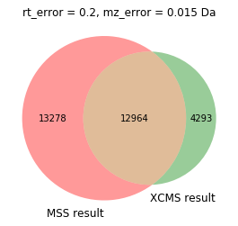
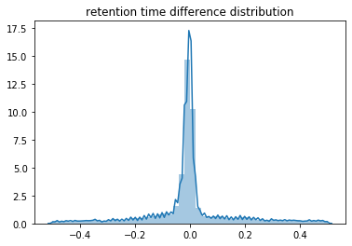
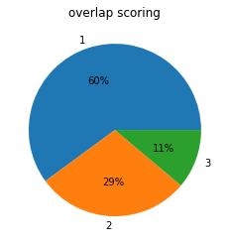
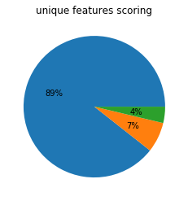
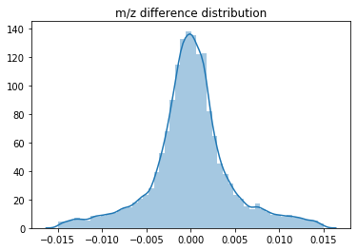
MSS vs XCMS
Reason: unique features mostly small peaks, the model built on the larger peaks

Slide 3
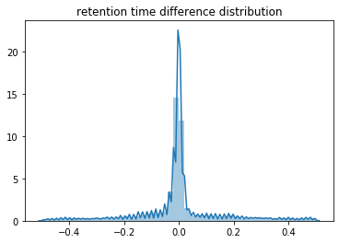
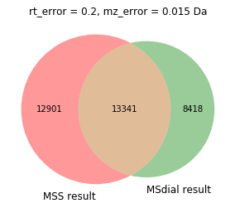
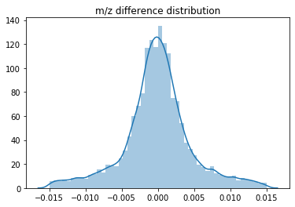
MSS vs msdial

Slide 4
Sample used
ENTACT sample from an EPA project
Multiple standards were spiked into samples, three samples were selected for the validation:
ENTACT_505: 146 compound detected in instrument
ENTACT_506: 150 detected
ENTACT_507: 113 detected
All the detections were verified manually on raw data by checking the chromatograms

Slide 5
Manual validation using ENTACT dataset
505 dataset
Peak list generated 142 out of 147 matched, 5 didn’t match
Peak picking function check 146 of 147 matched
1 because scan number didn’t meet criteria
4 because of mz slicing issue – didn’t select correct mz for peak picking
506 dataset
Peak list generated 151 out of 153 matched, 2 didn’t match
Peak picking function check 151 of 153 matched
1 from pipeline because of mz slicing issue – didn’t select correct mz for peak picking, 1 has integration issue from mz slicing
1 feature has been mis integrated
508 dataset
Peak list generated 109 out of 113 matched, 1 unsure, 3 didn’t match
Peak picking function check 111 of 113 matched
2 because of bad peak shape/scan number
2 because of mz slicing issue – didn’t select correct mz for peak picking

Slide 6
Debugging
The integration and peak detection mismatch were mainly from mz slicing → proper mz were not selected thus detection was not completed
Current logic: slice the whole mz space by 2*err step
Refine: slice the whole mz space by 1*err step
Ideally: slice the whole mz space using density estimation

